Slide 1
AZURE KUBERNETES SERVICE
Cluster with Managed Identity
Secure & Reliable Deployment of Student Management Microservices
Microservices
Private ACR
Pod-level Identity
Course 24CC3046 • Microsoft Certified Azure Administrator Associate
Review 1 • Proposal & Design • Odd Semester 2026–27
Team: Nekkanti Lekhyasree • Maganti Sruthi • Lingineni Rohith Kumar • Koppu Venu Sooraj

Slide 2
Team Members & Roles
Four focused workstreams with one shared end-to-end architecture
Containerization & Application Packaging
Azure Container Registry & AKS Deployment
01
02
Nekkanti Lekhyasree-240031881
Docker, Dockerfiles, container images, container configuration, preparing Student/Course services for deployment
Maganti Sruthi-2400032349
ACR, AKS cluster, Kubernetes Pods, Deployments, Services, image pulling, replicas
Identity & Security
Networking, Reliability & Monitoring
03
04
Koppu Venu Sooraj -2400031962
Managed Identity, Microsoft Entra Workload Identity, Service Accounts, Federated Identity, RBAC, Key Vault
Lingineni Rohith Kumar - 2400032006
VNet, Subnet, NSG, node-pool upgrades, pod eviction, probes, rolling updates, Azure Monitor
Shared responsibility: every member understands the full flow from application → container → AKS → identity → Azure resources.
2
Azure Kubernetes Service • Managed Identity • Student Management Microservices

Slide 3
Project Overview
The Student Management application is the demonstration workload for the AKS + Managed Identity problem
Application
Cloud platform
Security focus
A simple microservices system with:
• Student Service
• Course Service
• REST APIs
• PostgreSQL database
• Dockerized Spring Boot services
Azure Kubernetes Service (AKS)
• Pods run the services
• Private ACR stores images
• Kubernetes manages deployment
• Networking controls traffic
Pod-level identity through:
Pod → Service Account →
Entra Workload Identity →
Managed Identity → RBAC →
Azure resource
3
Azure Kubernetes Service • Managed Identity • Student Management Microservices

Slide 4
Problem Statement
Hackathon focus: secure workload identity, private image access, and reliable AKS operations
Deploying microservices on AKS requires secure authentication from workloads to Azure resources.
Private container images must be pulled securely from Azure Container Registry.
Workload Identity Federation setup can be error-prone when issuer, subject, audience, service account, and permissions do not match.
AKS node pool upgrades can evict or restart pods and may cause service disruption if workloads are not designed for it.
The project demonstrates practical ways to reduce these risks using identity, least privilege, and Kubernetes resilience features.
Two official bottlenecks
01 Workload identity federation setup
02 Node pool upgrade → pod eviction / disruption
The Student Management application provides a realistic workload for demonstrating both.
4
Azure Kubernetes Service • Managed Identity • Student Management Microservices

Slide 5
Objectives
What the project is designed to achieve
1. Build
2. Containerize
3. Private registry
Create Student and Course Spring Boot microservices.
Package each service as a Docker image.
Store images in a private Azure Container Registry.
4. Deploy
5. Identity
6. Resilience
Run the microservices as pods on AKS.
Use Entra Workload Identity with a managed identity.
Reduce upgrade-related disruption with replicas and health checks.
5
Azure Kubernetes Service • Managed Identity • Student Management Microservices

Slide 6
Use Case / Real-World Scenario
A university can use the same pattern for student and course operations
AKS
Student Service
Examples
Student:
• Register
• View
• Update
• Delete
Course:
• Create
• View
• Update
• Delete
Student / Faculty
/Admin
Azure
PostgreSQL
AKS
Course Service
The cloud architecture separates application concerns while AKS handles container orchestration and scaling.
6
Azure Kubernetes Service • Managed Identity • Student Management Microservices

Slide 7
Azure Services Used
Core Azure services mapped to their role in the solution
AKS
Azure Container Registry
Runs and orchestrates microservice pods
Private storage for Docker images
Microsoft Entra ID
Managed Identity
Identity platform used by Workload Identity
Azure identity assigned to workloads
Azure RBAC
Azure Database for PostgreSQL
Controls what the identity can access
Persistent relational application data
VNet + NSG
Azure Monitor
Network isolation and traffic controls
Logs, metrics and operational visibility
7
Azure Kubernetes Service • Managed Identity • Student Management Microservices

Slide 8
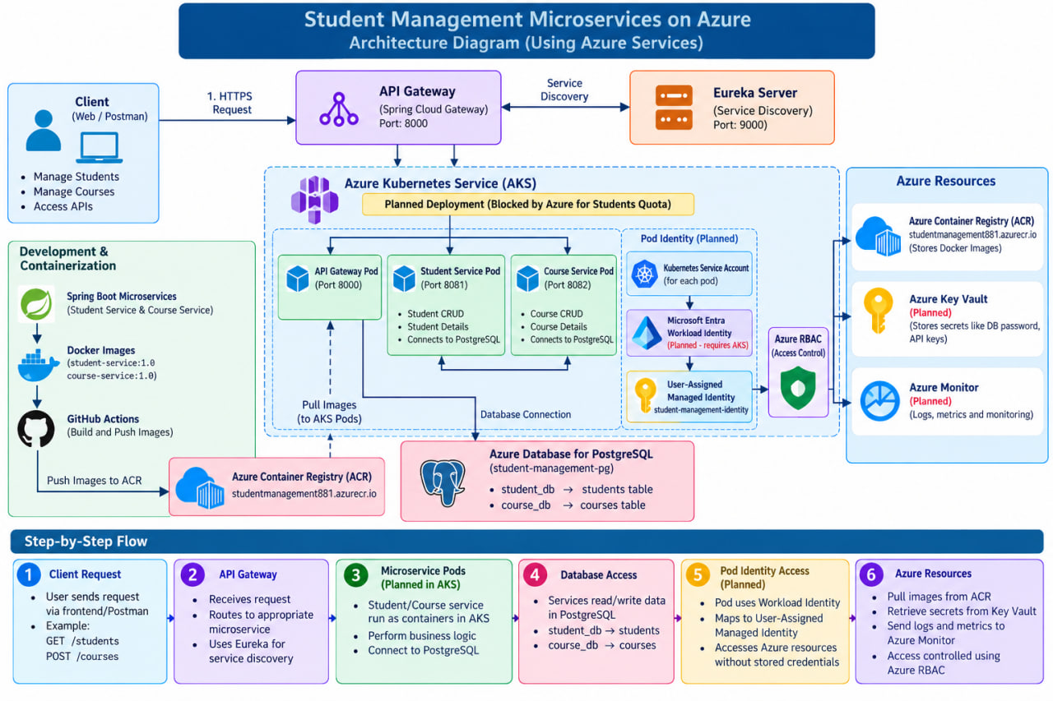

Slide 9
Azure Resource Configuration
Planned resource layout for the implementation
Resource Group
AKS Cluster
Single logical container for project resources
Cluster with node pool for application pods
Azure Container Registry
PostgreSQL
Private registry with student-service and course-service images
Database for student and course data
Managed Identity
VNet / Subnet / NSG
Identity used by the workload
Controlled network boundary for AKS
Actual SKU, region and sizing should be selected according to the team's Azure subscription and budget.
9
Azure Kubernetes Service • Managed Identity • Student Management Microservices

Slide 10
Implementation Approach
Build locally first, then move the same containers to Azure
01 Develop
02 Database
03 API test
04 Containerize
Spring Boot Student + Course services
Connect and test PostgreSQL
Validate CRUD endpoints with Postman
Create Docker images
05 Registry
06 Deploy
07 Secure
08 Validate
Push images to private ACR
Create AKS Deployments + Services
Configure Workload Identity + RBAC
Test identity, image pull and upgrades
10
Azure Kubernetes Service • Managed Identity • Student Management Microservices

Slide 11
Configuration & Deployment
Kubernetes objects connect images, pods, services and identities
Deployment
Service
Identity config
Student Deployment
• Image: private ACR
• Replicas: 2+
• Readiness probe
• Liveness probe
Course Deployment
• Same pattern
• Independent rollout
Kubernetes Service
• Stable internal endpoint
• Routes traffic to pods
• Selector targets labels
This keeps application access independent of pod IP changes.
Service Account
+
Workload Identity labels/annotations
+
Federated identity credential
+
Managed Identity + RBAC
11
Azure Kubernetes Service • Managed Identity • Student Management Microservices

Slide 12
Security & Access Management
Authentication identifies the workload; RBAC limits what it can do
Student Pod
Kubernetes
Service Account
Entra
Workload Identity
Managed
Identity
Azure
Authentication
Authorization
Security principle
The workload proves which Azure identity it should use.
Azure RBAC defines the resources and actions allowed.
Use least privilege and avoid hard-coded Azure credentials.
12
Azure Kubernetes Service • Managed Identity • Student Management Microservices

Slide 13
Networking Configuration
Keep workload traffic controlled and predictable
VNet
Logical private network boundary
AKS subnet
Hosts AKS networking resources
NSG
Controls permitted inbound/outbound traffic
Public entry
Only expose required application endpoints
Private workload traffic
Service-to-service/database traffic stays controlled
Design goal: minimize exposed endpoints and apply network controls at the appropriate subnet/resource boundaries.
13
Azure Kubernetes Service • Managed Identity • Student Management Microservices

Slide 14
Storage Configuration
Persistent data is separated from stateless application pods
Student data
Course data
Optional Blob Storage
• Student ID
• Name
• Email
• Department
• Year
Stored in PostgreSQL.
• Course ID
• Course code
• Course name
• Credits
• Department
Stored in PostgreSQL.
Can be added for documents or other unstructured files.
Workload Identity can be used for secure Azure access without putting credentials in code.
Database access should use secure connection settings and environment/secret management rather than hard-coded credentials.
14
Azure Kubernetes Service • Managed Identity • Student Management Microservices

Slide 15
Monitoring & Management
Operational visibility helps verify that the cluster is healthy
Pod health
Deployment state
kubectl get pods
Readiness / liveness probes
Replica count
Rollout status
Application logs
Azure Monitor
Spring Boot logs
Error diagnosis
Metrics, logs and alerts
Operational visibility
Management checks: pod status → service endpoints → logs → resource health → identity/access behavior.
15
Azure Kubernetes Service • Managed Identity • Student Management Microservices

Slide 16
Testing & Validation
Validate each layer before the final end-to-end demo
Application
Container
Registry
CRUD APIs return expected responses
Docker image runs locally
AKS can pull the private image
Identity
Authorization
Reliability
Pod receives the intended workload identity
RBAC allows only required Azure actions
Pods remain available during controlled updates
Evidence can include Postman responses, Docker/ACR images, kubectl output, AKS deployment state and identity configuration.
16
Azure Kubernetes Service • Managed Identity • Student Management Microservices

Slide 17
Challenges Faced & Solutions
Focus on the two bottlenecks identified for the hackathon
Challenge 1 — Workload Identity Federation
Challenge 2 — Node Pool Upgrades
Problem:
Configuration can fail when the federated credential does not match the Kubernetes service account or token claims.
Response:
• Keep issuer/subject/audience consistent
• Verify service account labels/annotations
• Verify federated credential
• Verify managed identity + RBAC
• Test access from the actual pod
Problem:
Upgrades can evict or restart pods.
Response:
• Use multiple replicas
• Add readiness/liveness probes
• Use rolling update strategy
• Use disruption controls where appropriate
• Verify application behavior during controlled upgrades
17
Azure Kubernetes Service • Managed Identity • Student Management Microservices

Slide 18
Performance / Results
Target validation results for the completed implementation
API correctness
Deployment
CRUD operations work for students and courses
Both services run as healthy AKS pods
Private images
Identity
Images are stored in ACR and pulled by AKS
Workload identity path is validated from pod to Azure
Reliability
Operations
Multiple replicas and probes reduce disruption risk
Logs and cluster status support troubleshooting
Important: final measured latency, availability and cost values should be inserted after the actual deployment and testing.
18
Azure Kubernetes Service • Managed Identity • Student Management Microservices

Slide 19
Cost Considerations
Azure cost depends on region, tier, usage and the team's subscription/credits
AKS
Cluster/node infrastructure and associated resources
ACR
Registry storage and operations
PostgreSQL
Compute, storage and backup
Azure Monitor
Log ingestion and retention can incur charges
Identity / RBAC / NSG
Core capabilities generally do not have a separate per-use charge
Cost-control practices: delete unused resources, choose appropriate SKUs, limit log retention, and monitor spending.
19
Azure Kubernetes Service • Managed Identity • Student Management Microservices

Slide 20
Lessons Learned
Key technical takeaways from the project
Microservices become easier to deploy and scale when each service is independently containerized.
ACR provides a private image source for AKS deployments.
Pod-level identity separates workload authentication from application code and avoids embedding Azure credentials.
Managed Identity and Azure RBAC work together: identity establishes who the workload is; RBAC controls what it can access.
Kubernetes resilience features matter during node maintenance and upgrades.
Configuration consistency is critical across Kubernetes, Entra ID, federated credentials and Azure RBAC.
20
Azure Kubernetes Service • Managed Identity • Student Management Microservices

Slide 21
Future Enhancements
Possible next steps after the core hackathon implementation
Frontend
Autoscaling
Observability
React dashboard for students, faculty and admins
Horizontal Pod Autoscaler based on workload
Dashboards and alerts using Azure Monitor
CI/CD
More services
Document storage
Automated build → ACR → AKS deployment pipeline
Authentication, notification or enrollment services
Use Blob Storage with workload identity
21
Azure Kubernetes Service • Managed Identity • Student Management Microservices

Slide 22
Conclusion
Secure identity + private images + resilient AKS workloads
The project demonstrates a practical Azure-native pattern for running student management microservices on AKS.
Secure
Private
Reliable
Workload Identity + Managed Identity + RBAC reduce the need for embedded credentials.
Docker images are stored in a private ACR and consumed by AKS.
Replicas, probes and controlled rollouts help reduce upgrade-related disruption.
Overall flow: Spring Boot → Docker → ACR → AKS → Workload Identity → Managed Identity → Azure resources
22
Azure Kubernetes Service • Managed Identity • Student Management Microservices

Slide 23
Live Demo
Recommended order for the final demonstration
1. Show application
2. Test CRUD
3. Show Docker
4. Show ACR
Open Student/Course APIs or frontend.
Create, read, update and delete sample records.
Display the service images and tags.
Show private repositories and pushed images.
5. Show AKS
6. Show identity
7. Validate access
8. Reliability
Display nodes, deployments, services and pods.
Explain service account → Workload Identity → Managed Identity.
Demonstrate the intended Azure resource access.
Show rollout/replica/probe configuration and explain upgrade handling.
23
Azure Kubernetes Service • Managed Identity • Student Management Microservices

Slide 24
Thank You
Azure Kubernetes Service Cluster with Managed Identity
Student Management Microservices
Nekkanti Lekhyasree • Maganti Sruthi • Lingineni Rohith Kumar • Koppu Venu Sooraj

